Slide 1
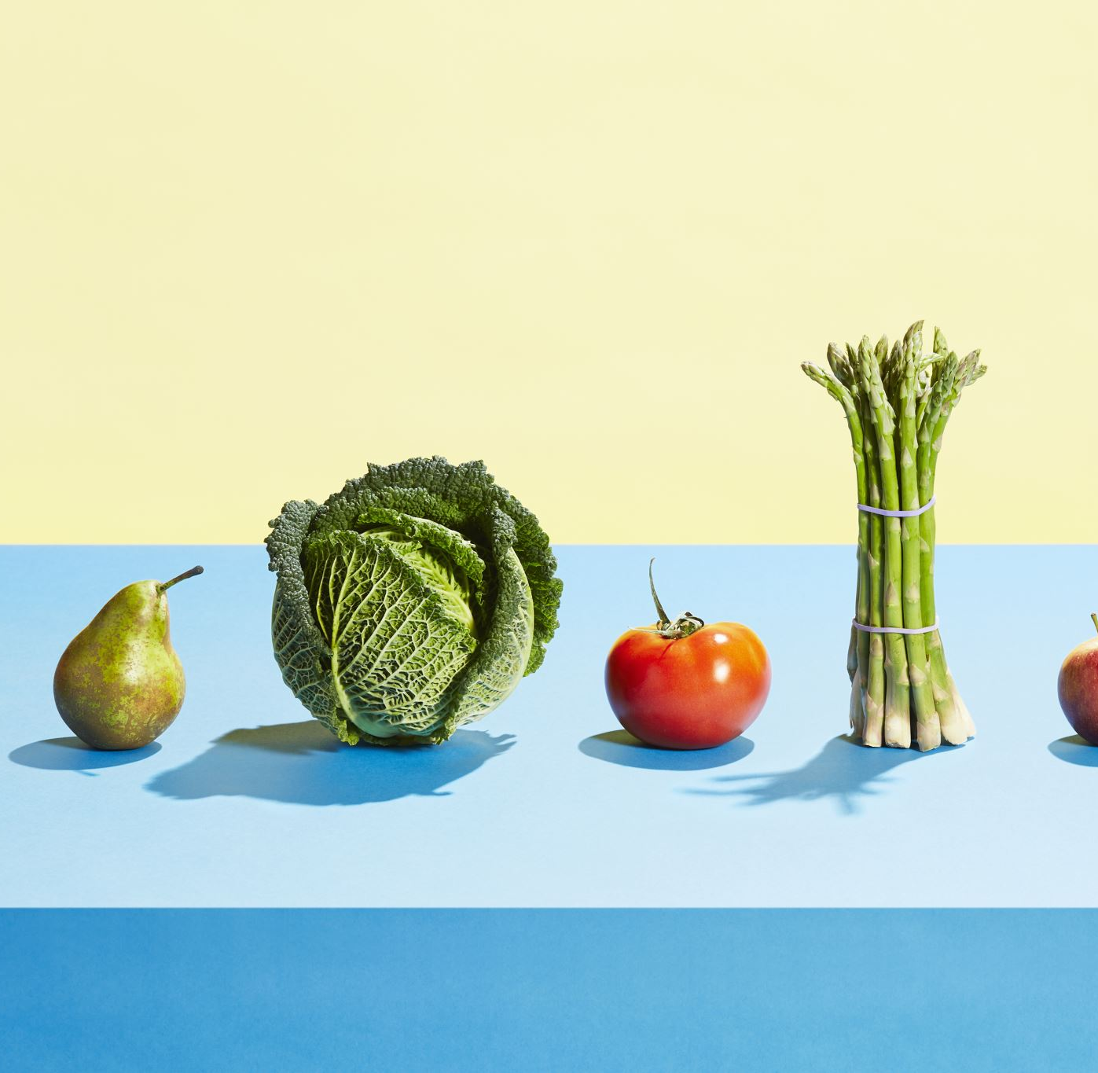
Demand Forecasting For Grocery Stores
Using Deep Learning Methodologies
Data Mining and Machine Learning II
Data Analytics

Slide 2
Introduction
Forecasting of real-time products in various supermarket groceries chains.
Helps stores to fill-up their stocks according to predicted sales.
Helps store to set some discounts or offers on specific food items.
We have used historical data to find out future sales.

Slide 3
Methodology
We have used following Time series and deep learning methods for this research :
Fb-Prophet model
Holt - Winter’s model
LSTM model
ARIMA model
Linear Regression model
Simple Moving Average
Naive Bayes

Slide 4
Results
Model used | RMSE Value
Fb-Prophet Model | 241.53
ARIMA Model | 284.02
Holt’s Model | 298.98
Linear Regression | 329.07
Simple Moving | 337.51
Average Moving | 242.47
LSTM Method | 245.04
Naive Bayes Method | 329.13
If we look at the results table, we have RMSE value which tells us how the predicted data is away from the value expected.
We can clearly say that Fb-Prophet Model is best fit among others.
Average Moving & LSTM also worked good on our dataset.

Slide 5
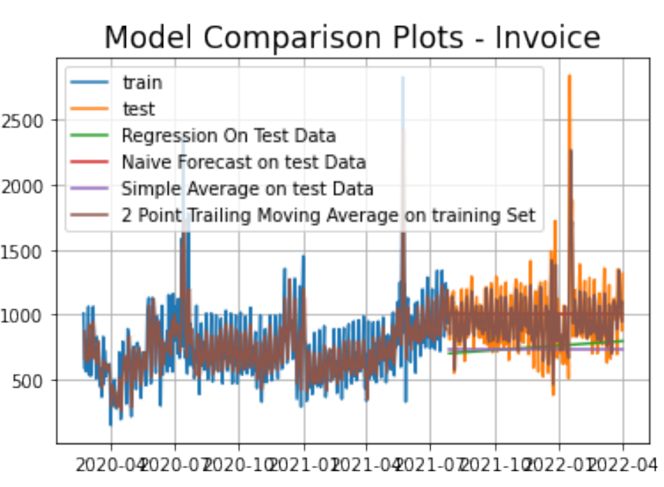
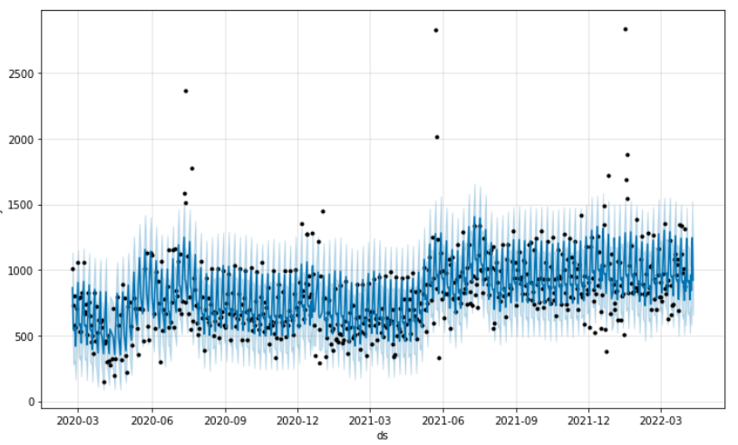
Continued
In first figure, you can see all models were compared with each other in graphical format.
Fb-Prophet model had helped us to forecast trend which followed daily, weekly and yearly manner.
Second figure describes the lower and highest range of the sales prediction of product ‘Chicken Tikka’

Slide 6
Conclusion
Prediction were done on products of different supermarket stores like ALDI, TESCO, LIDL.
Deep learning and time series methods were applied on dataset.
Best method selected using RMSE value
Best algorithm : Fb-Prophet Model (RMSE value: 241.53)

Slide 7
Future Work
In future, some methods like Gradient Boosting can be used. When we combine this with previous models, this will help to reduce overall prediction error.

Slide 8
Thank You !!!

